Slide 1
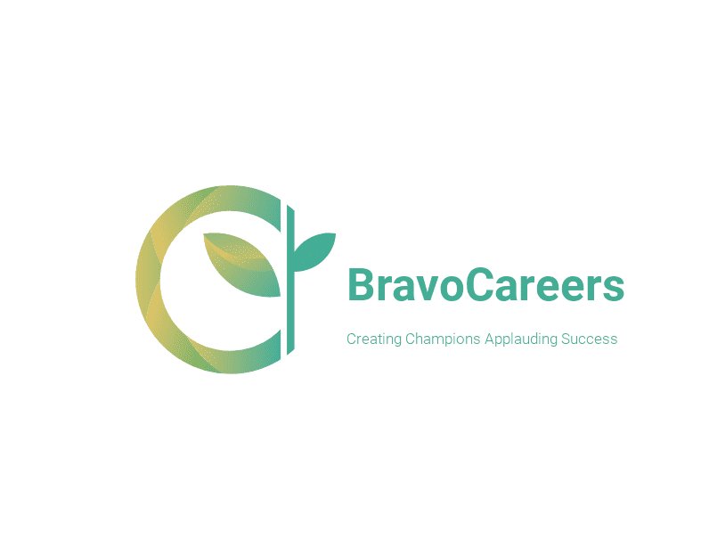
Bravo careers
Team A

Slide 2
Product: Responsive website.
Client Name: Bravo careers / Arif Systems
Project Description:
A modern web platform with modern design language, layout, responsiveness, optimization and accessibility especially focused on the mobile first design philosophy and layout. The business implementation is that potential clients can engage directly with the consultants and the consultants can manage a better client relationship.
Responsive design- It is a new website design concept in which a website scales/transforms form desktop, tablet and mobile interface by using only one codebase.
Progress: The basic framework is laid out and we just need to add more content

Slide 3
Client requirements
Design and implement Responsive website
Modern design language and modern aesthetic
Mobile friendly
Use of modern STACK as old website technologies are now obsolete
Easy content management system for blogs and announcements
Appointment service for clients

Slide 4
30361543 | Ajit Kunwar | Scrum Master/Tester/DB
30361559 | Birendra Rokaha | Product Manager/ Design and Code
30323980 | Petar Petrov (Left the Uni) | Development Team/Design and Code
30347752 | Sushant Adhikari | Documentation/Tester
30117452 | Chao Zhang (Newly added member on 3 april,2020) | Client communication/Design

Slide 5
Tools and Technologies
Design and prototype: Figma
IDE: Visual studio code for frontend and Backend coding
Front end technologies: This is the code that runs on client’s device and contains layout and interface. HTML5, CSS3, SASS, Bootstrap and Vanilla JavaScript
Back end technologies: This is the code that runs on the servers and contain all the business logic. MERN stack: MongoDB(database), Express, React and NodeJS
Debugging and testing: Chrome Developer Tools and Firefox Developer Tools
Git Repository: GitHub
Team collaboration: Microsoft teams, Messenger, Trello and Skype
Documentation storage and sharing: Google Drive, Google Docs and Gmail
Experimental/Alt. technologies: Django (AI chatbot), Angular and Vue

Slide 6
Progress so far
Design layout is ready and set up. Fully functioning prototype live through Figma online. Peter (Left University) has the prototype and we are communicating with him to get the files.
Backend code has started.
As of this documentation all files are available for anyone on GitHub and Microsoft teams
The basic framework has been setup and need to add more content.

Slide 7
Progress made during break
Each member conducted further reading in their appointed domains.
Birendra – React, NodeJS, Express, MongoDB, HTML, CSS and JS.
Ajit – MongoDB, Express, HTML, CSS and JS.
Sushant – Chrome developer tools, VSC debugger, HTML, CSS and JS.
We looked at various industry trends to gather more requirements and tweak our designs further.
Got some experimental ideas that we may try to implement.
We also worked on some client feedback from the first project to add additional features into the website design and change few layout patterns.

Slide 8
Potential features
Chatbot: Our team is looking to implement a chatbot that will automatically guide users to their desired services. However, it is very vast task, difficult to implement and not required by the client, so as of today it is still only in initial analyzation phase.
24/7 support: A support chat service so clients can connect easily with their respective consultants

Slide 9
Sprint 3
Requirements | Condition and satisfaction | Task and estimates | Estimated time
SD2: Initial design prototype | Creation of an initial design prototype using the prototyping software - Figma. | T1: Creating a theme by following standard design patterns for the website. T2: Creating a design mock up using Figma. T3: Every member reviews the prototype and provides feedback. | 2 hours

Slide 10
Add all backlog items

